Slide 1
AUTOMATION TEST
Prepared by Doan Hong Hieu Kien
Date: July 15th, 2024

Slide 2
Training Objectives
Study about Automation Testing:
Definition, Types of Automation Framework
Key features of a Good Automated Test
Benefits of Automation Testing
Study about Selenium:
Selenium Framework, Selenium IDE and Selenium WebDriver
Design a simple testcase using Selenium
Logging, Test Report
Logging module
Pytest-html in generating Test Report
Push notifications to Microsoft Teams

Slide 3
Content Table
Part-I: Introduction to Automation Testing
Part-II: Selenium Automation Framework
Part-III: Design simple test cases using Selenium and Python
Part-IV: Logging and Generate Test Report using Python
Part-V: Integrate push notifications in Microsoft Teams using Python

Slide 4
PART-I: INTRODUCTION TO AUTOMATION TESTING

Slide 5
Definition
Automation testing is a software testing technique that automates the process of validating the functionality of software and ensures it meets requirements before being released into production.
Organization can run specific software tests at a faster pace without human testers.

Slide 6
Key Features of a Good Automated Test
Executed programmatically
Repeatable
Test ends with a validation
Stable enough to be used in CI / CD
Easy to understand
Requires as little maintenance as possible
Test is independent and can run in parallel with all other tests

Slide 7
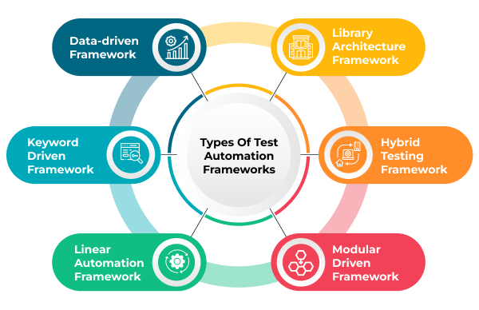
Types of Automation Testing Framework

Slide 8
Types of Automation Testing Framework (cont’d)
Linear Automation Framework:
Also referred to as a record-and-playback framework
Testers do not need to write code to create functions and the steps are written in sequential order
Tester records each step (navigation, user input, checkpoints, etc.), plays the script back automatically to conduct the test

Slide 9
Types of Automation Testing Framework (cont’d)
Advantages:
No need to write custom code
One of the fastest ways to generate test scripts
Easy to understand the test workflow
Easy to get up and running with automated testing, especially with a new tool
Disadvantages:
Test scripts are not reusable
Maintenance is considered a hassle

Slide 10
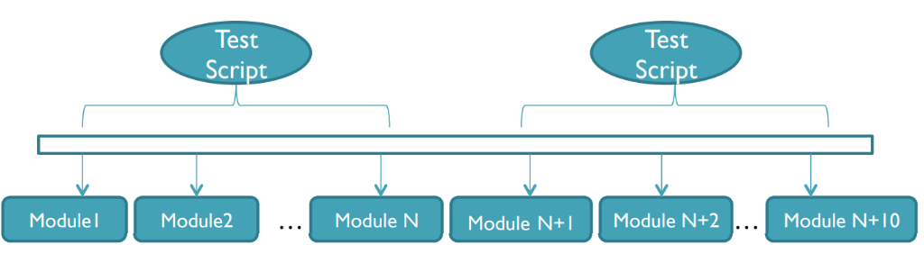
Types of Automation Testing Framework (cont’d)
Modular Based Testing Framework:
The framework builds an abstract layer for a component to hide that component from the rest of the application. Therefore, the changes made to the other part of the application do not affect that component.
Involve the creation of small, independent scripts that represent the modules of the application under test. These modules in turn are used in a hierarchical fashion to build large test cases.

Slide 11
Types of Automation Testing Framework (cont’d)
Advantages:
Only fix the module and its associated individual test script if any changes are made to the application.
Less effort to create test cases.
Disadvantages:
Data is hard-coded into the test script, cannot use multiple data sets.
Programming knowledge is required to set up the framework.

Slide 12
Types of Automation Testing Framework (cont’d)
Library Architecture Testing Framework:
Based on Modular framework.
Similar tasks within the scripts are identified and later grouped by function. These functions are kept in a library which can be called upon by the test scripts whenever needed.

Slide 13
Types of Automation Testing Framework (cont’d)
Advantages:
Test maintenance and scalability becomes easier and more cost effective
Higher degree of reusability
Disadvantages:
Data is hard-coded into the test script.
Technical expertise is needed to write and analyze the common functions within the test scripts.

Slide 14
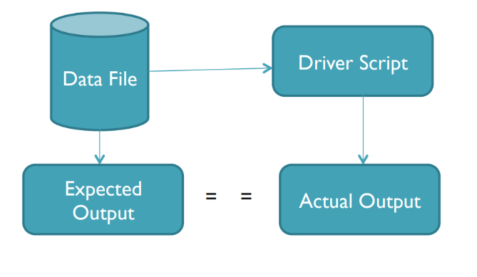
Types of Automation Testing Framework (cont’d)
Data – Driven Testing Framework:
The test input and the expected output results are stored in a separate data file (normally in a tabular format) so that a single driver script can execute all the test cases with multiple sets of data.
The driver script contains navigation through the program, reading of the data files and logging of the test status information.

Slide 15
Types of Automation Testing Framework (cont’d)
Advantages:
Tests can be executed with multiple data sets.
Multiple scenarios can be tested quickly by varying the data.
Hard-coding data can be avoided.
Save time
Disadvantages:
Need a highly-experienced tester.
Setting up a data-driven framework takes a significant amount of time.

Slide 16
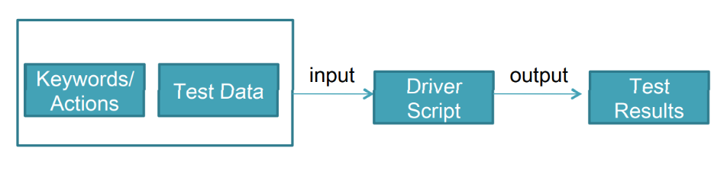
Types of Automation Testing Framework (cont’d)
Keyword – Driven Testing Framework:
An application independent framework utilizing data tables and self-explanatory keywords to explain the actions to be performed on the application under test.
The test data and the directives (called keywords) telling what to do which in the test scripts are put in the external input data file.

Slide 17
Types of Automation Testing Framework (cont’d)
Advantages:
Minimal scripting knowledge is needed.
A single keyword can be used across multiple test scripts, so the code is reusable.
Test scripts can be built independent of the AUT (application under test).
Disadvantages:
Initial cost of setting up the framework is high.
Need an employee with good test automation skills.
Keywords can be a hassle to maintain when scaling a test operation.

Slide 18
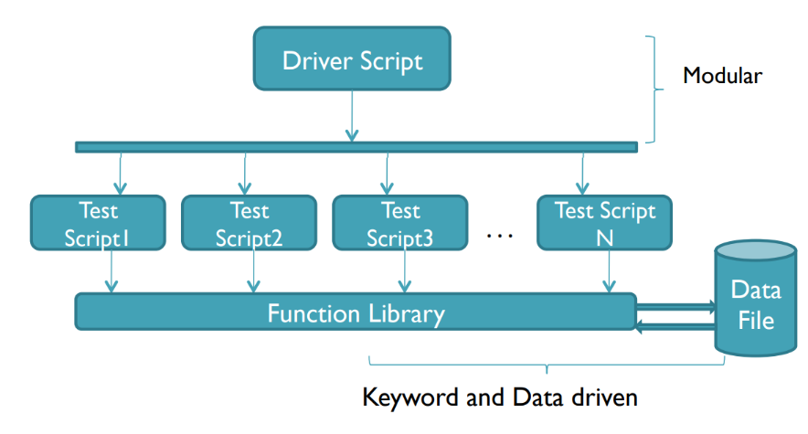
Types of Automation Testing Framework (cont’d)
Hybrid Testing Framework:
A combination of any of the previously mentioned frameworks to leverage the advantages of some and mitigate the weakness of others.

Slide 19
Benefits
Cost efficiency
Improve test accuracy
Improve test coverage
Maximize ROI (Return on Investment)
Fast Feedback loop
Better Allocation of Resources
Detects bugs earlier
Test at Scale

Slide 20
PART-II: SELENIUM AUTOMATION FRAMEWORK

Slide 21
Some definitions
Selenium Framework: is a suite of automation testing tools based on JavaScript framework. It could run the tests directly on the target browser, drive the interactions on the required web page and rerun them without any manual input. It eliminates repetitive manual testing that consumes lots of time and effort.
Selenium IDE: is an open – source record / run tool that a test case developer uses to develop Selenium Test cases. Selenium IDE is an easy – to – use tool from the Selenium Test Suite and can even be used by someone new to developing automated test cases for their web applications.
Download Selenium IDE: https://www.selenium.dev/downloads/

Slide 22
Some definitions (cont’d)
Selenium WebDriver: is the core component of Selenium which provides a programming interface for driving the web browsers. It allows us to write tests in different programming languages to interact with the web elements, simulate user interactions and perform assertions.

Slide 23
Why choose Selenium?
Allow running tests across various web browsers like Chrome, Firefox, Safari, IE, Opera, Edge.
Open - source, free to use and distributed with no upfront cost.
Support multiple programming languages: C#, Java, Ruby, Python and more.
Can integrate with various testing frameworks like JUnit, TestNG, NUnit and more.
Easy customization and extensibility to meet specific testing needs.
Test scripts can be executed on any operating system.
Allow parallel test execution, reduce overall testing time, enabling faster feedback and quicker releases.
Allow running tests repeatably.

Slide 24
Selenium in Python
Selenium Python bindings provides a simple API to write functional/acceptance tests using Selenium WebDriver. Through Selenium Python API you can access all functionalities of Selenium WebDriver in an intuitive way.
Selenium Python bindings provide a convenient API to access Selenium WebDriver like Firefox, IE, Chrome, Remote etc. The current supported Python versions are 3.5 and above.
Selenium 2 WebDriver API is used.
Current version: 4.22.0

Slide 25
Install Selenium for Python
Install using pip: pip install selenium
For browser drivers, download via the following links:
Chrome: https://chromedriver.chromium.org/downloads
Firefox: https://github.com/mozilla/geckodriver/releases
Edge: https://developer.microsoft.com/en-us/microsoft-edge/tools/webdriver/
Safari: https://webkit.org/blog/6900/webdriver-support-in-safari-10/

Slide 26
PART-III: DESIGN SIMPLE TEST CASES
USING SELENIUM AND PYTHON

Slide 27
Environment for Testing
OS: Microsoft Windows 10 Enterprise (64bit)
Python version: 3.9.6
Selenium version: 4.22.0
Chrome version: 126.0.6478.183
Support tool: Visual Studio Code, Selenium IDE
URL for Testing: https://elearning.dai-ichi-life.com.vn/

Slide 28
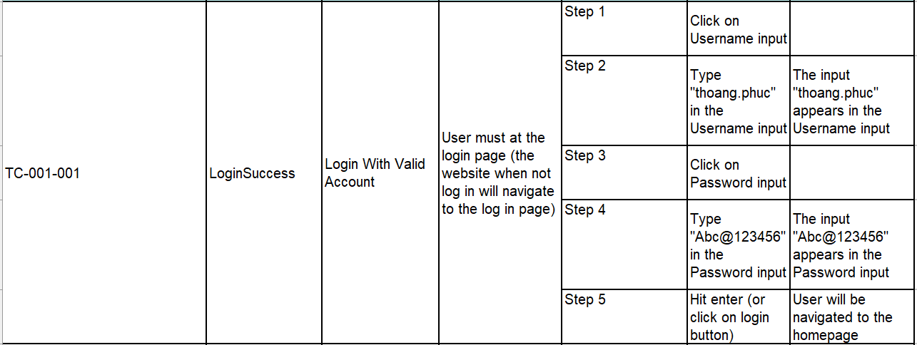
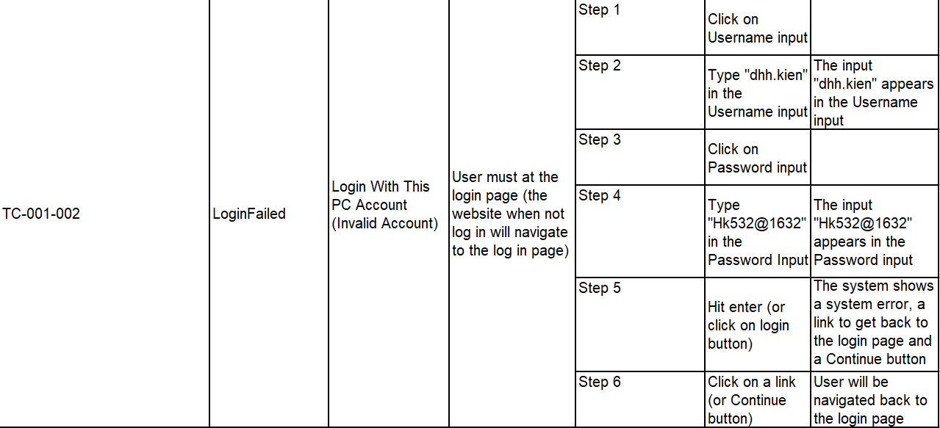
Test Case and Test Scenario
Log In

Slide 29
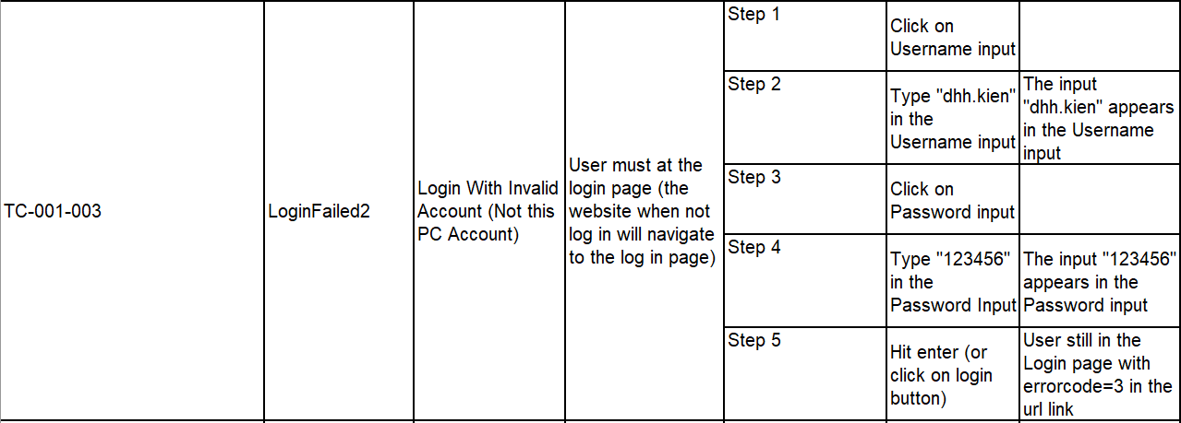
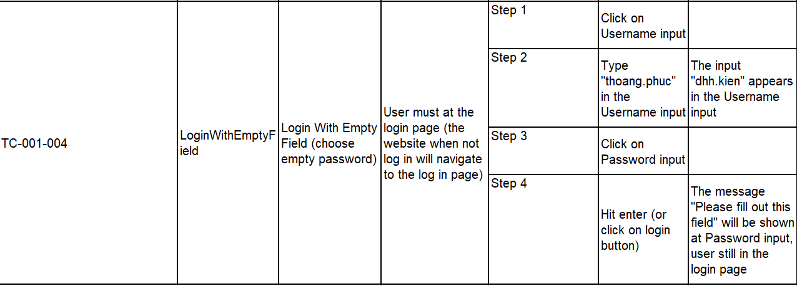
Test Case and Test Scenario (con’t)

Slide 30
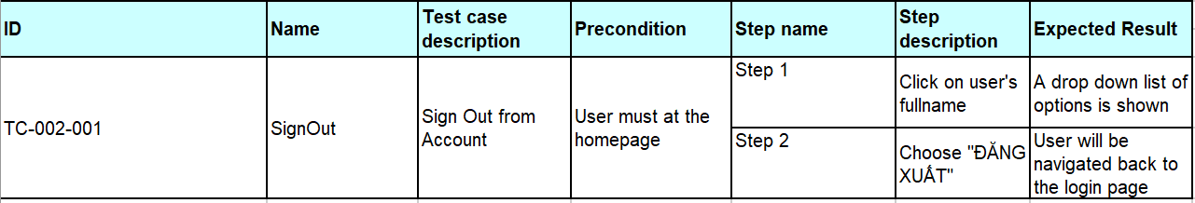
Test Case and Test Scenario (con’t)
Sign Out

Slide 31
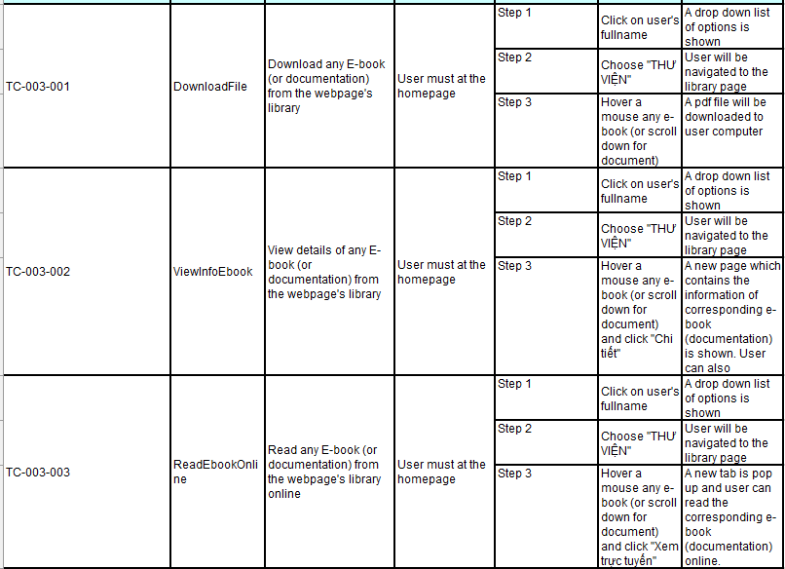
Test Case and Test Scenario (con’t)
Library Interaction

Slide 32
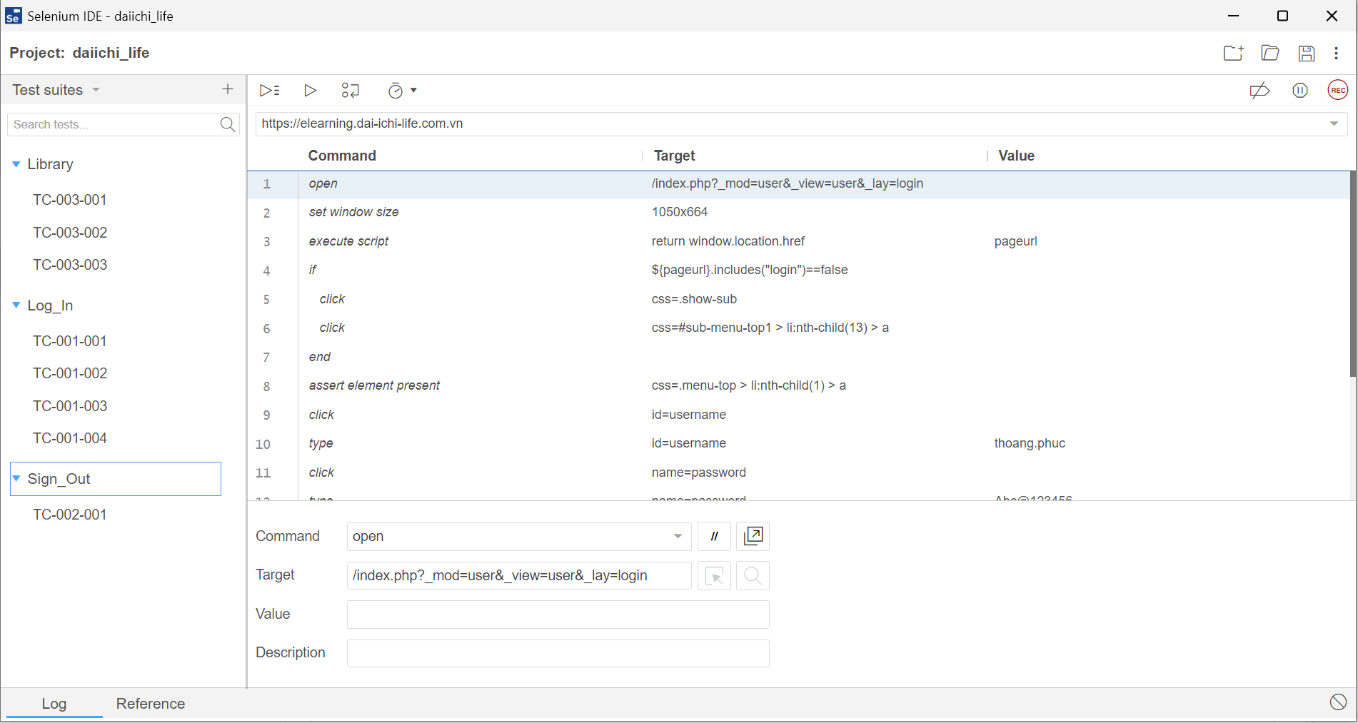
Test Suite structure in Selenium IDE

Slide 33
PART-IV: LOGGING AND GENERATING
TEST REPORT USING PYTHON

Slide 34
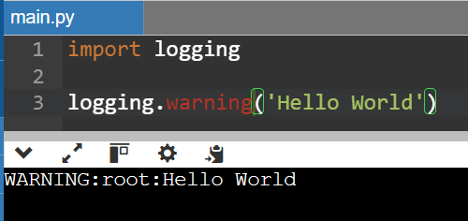
What is logging?
Logging refers to the process of recording or storing information or messages that help in understanding the behavior and execution of a program. It is a way to track the flow of the program and identify any issues or bugs.
Logging can be done in various programming languages, such as JavaScript, Python, or Java. In Python, logging module is used to track code execution.

Slide 35
Difference between logging and printing to console
Logging | Printing to console
Record events and errors that occur during the execution of Python programs. | Displays the information to the console for the debugging purposes.
Mainly used in the production environment. | Mainly for debugging.
Some features are Log levels, filtering, formatting, and more. | There are no good features.
It provides different log levels such as Debug, Info, Error, Warning, and Critical. | It does not have any levels; it simply prints whatever is passed to it.
Can be configured to log to different output destinations (e.g., console, file, network) | Prints only on the console

Slide 36
Test Report
A Test Report is a summary of all the tests that were done, what was intended to be achieved with them, and what were the testing results once the tests were complete. It aims to summarize the results of the entire testing process formally and shares a comprehensive view of the testing status overall.
Test Reporting helps foster collaboration among the team as well as the stakeholders, and it makes sure everyone involved in the software development process is on the same page.

Slide 37
How to generate Test Report in Python
We can use pytest-html as a supportive module to generate a HTML Test Report in Python (if unittest is used instead of Pytest, HTMLTestRunner can be used, but must be downloaded manually since it is not a standard python module).
To install, run pip install pytest-html
To generate HTML Test Report, simply run:
pytest --html=“directory_to_report” “some other args”

Slide 38
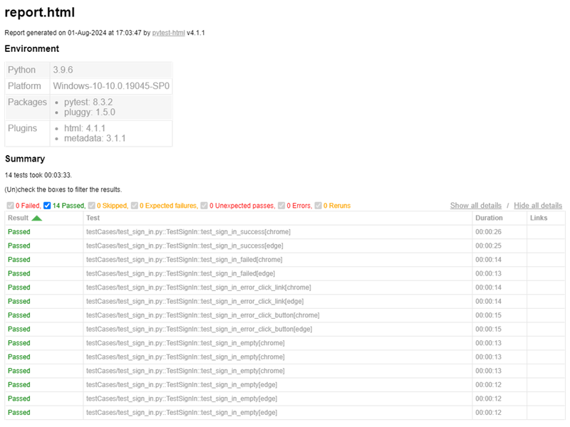
How to generate Test Report in Python (cont’d)

Slide 39
PART-V: INTEGRATE PUSH NOTIFICATIONS IN MICROSOFT TEAMS USING PYTHON

Slide 40
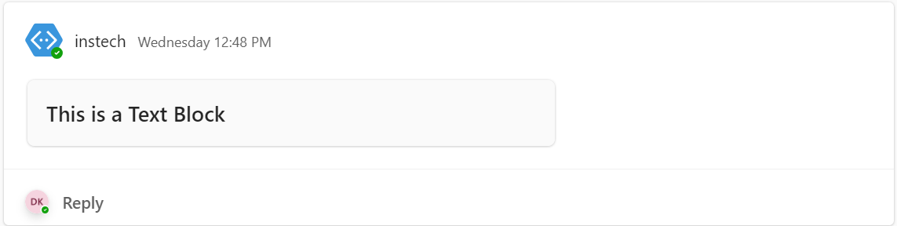
Purpose of Push Notifications in MS-Teams
Help promote urgent updates by automatically sharing the most important information in real-time with all users.
Push notifications can support the work of all company departments. Every department can share its communications with an automatic, customizable, and intuitive system.

Slide 41
What is Adaptive Card?
Adaptive Card is a platform – agnostic method of sharing and displaying blocks of information without the complexity of customizing CSS or HTML to render them. Adaptive Card is written in JSON format.
When delivered to a specific host, such as Microsoft Teams, the JSON file is transformed into native UI that automatically adapts to its host. Therefore, process designers can now offer consistent UI patterns whenever they need to show information as part of a business process/automation.
Since adaptive cards adapt to their host, they are perfect vehicles for sharing information between Microsoft Teams and other services.

Slide 42
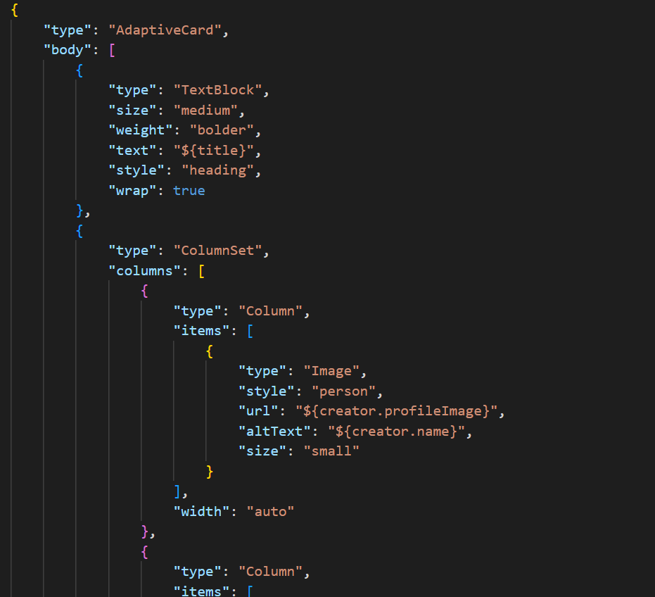
Example of Adaptive Card
Card reference: Samples and Templates | Adaptive Cards

Slide 43
Push Notifications in Python
Supportive module:
urllib3: a package that collects several modules for working with URLs
json: to convert a dictionary into JSON format and write to JSON file
Note: Can install pymsteams instead of using the above 2 modules
adaptivecardbuilder: to build an Adaptive Card. To install this module, run pip install adaptivecardbuilder
asyncio: for calling async function
html2image: render HTML to PNG file
base64: convert PNG to base64 format

Slide 44
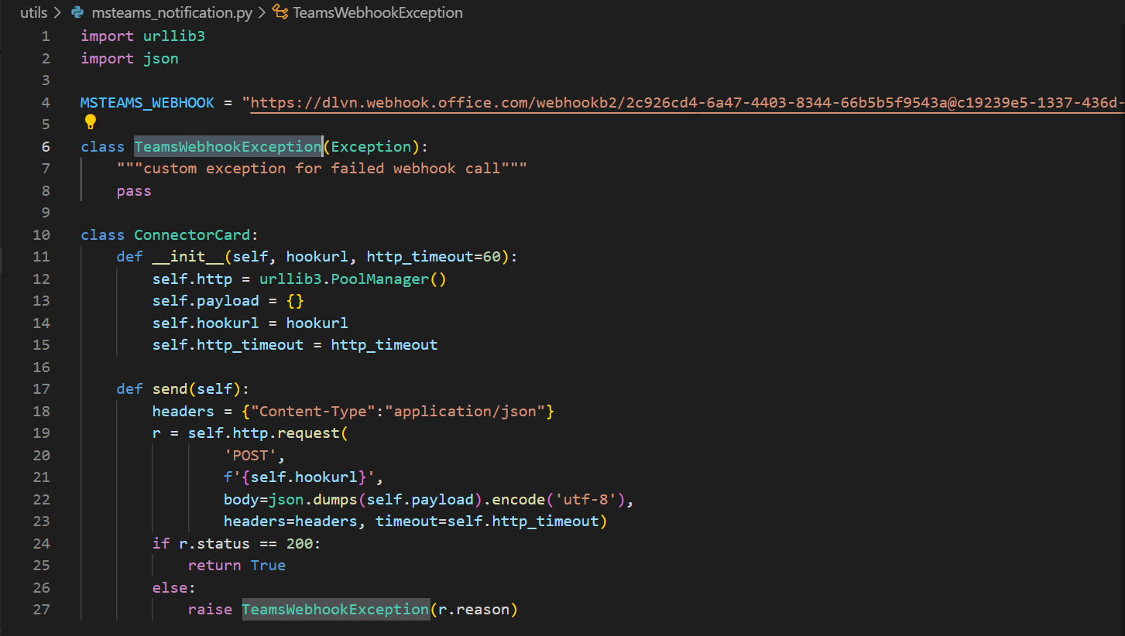
Push Notifications in Python (cont’d)
Class ConnectorCard: connect to MS-Teams webhook and send our Adaptive Card to the channel via that webhook

Slide 45
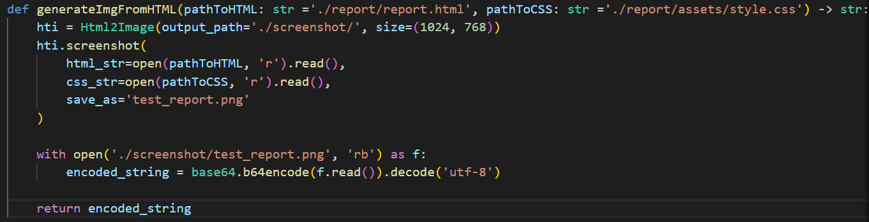
Push Notifications in Python (cont’d)
Render HTML to PNG file: a supportive method to generate PNG from HTML and CSS. This method also returns a base64 string format of the generated image

Slide 46
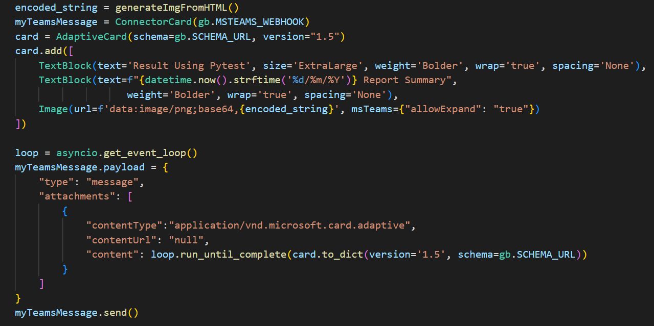
Push Notifications in Python (cont’d)
Generate Adaptive Card: adaptivecardbuilder is a powerful module to build an Adaptive Card without memorize too much syntax. Can use dictionary type instead, but the code will become hassle to maintain.

Slide 47
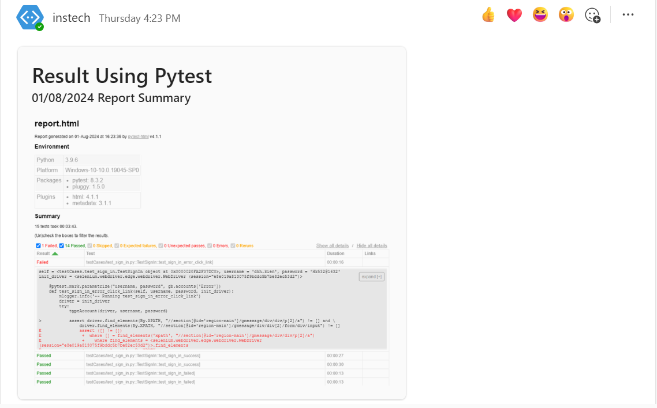
Push Notifications in Python (final result)

